Slide 1
Congressional Community Breakdown from 1979 to 2007
Sharp divisions between groups visible in later congresses
Number of groups differs between Senate and House

Slide 2
Degree Distribution
N(k) vs K
Weighted on left, unweighted on right
Grouped into 10’s because of small graph size

Slide 3
Is it a Power-Law Distribution?
Log(N(k)) vs log(K), weighted and unweighted
95th congress had a rules change – no limits on number of cosponsors
Weighted seems to be somewhat power-law, but “right shifted”

Slide 4
How about the Senate?
The community size is significantly smaller
No obvious power-law distribution, possibly due to the group size

Slide 5
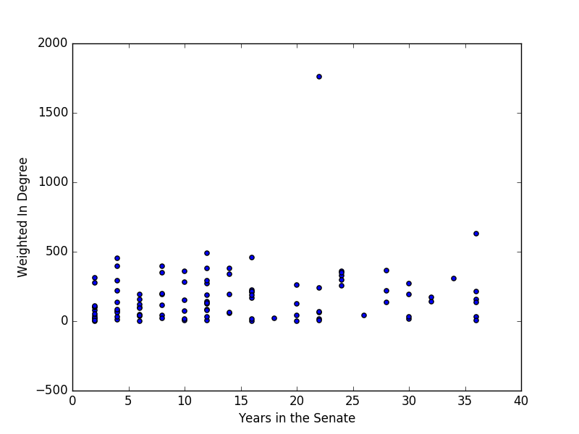
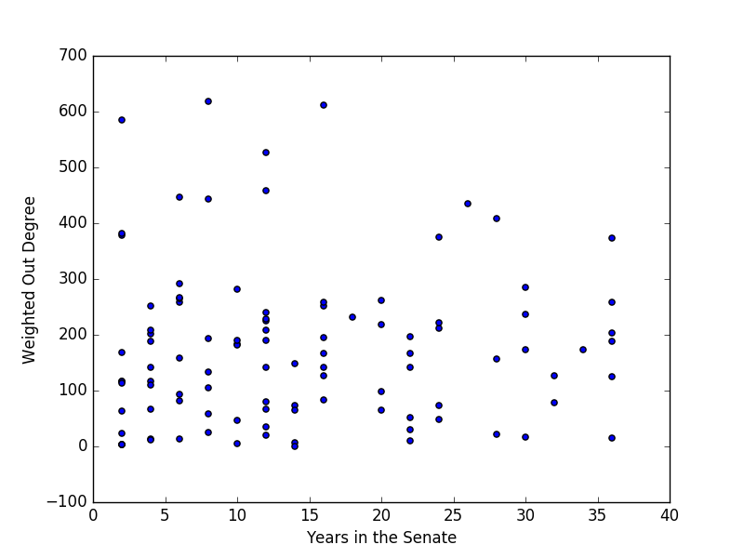
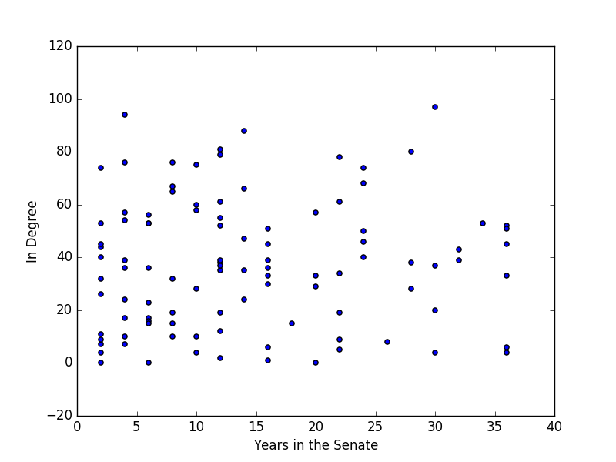
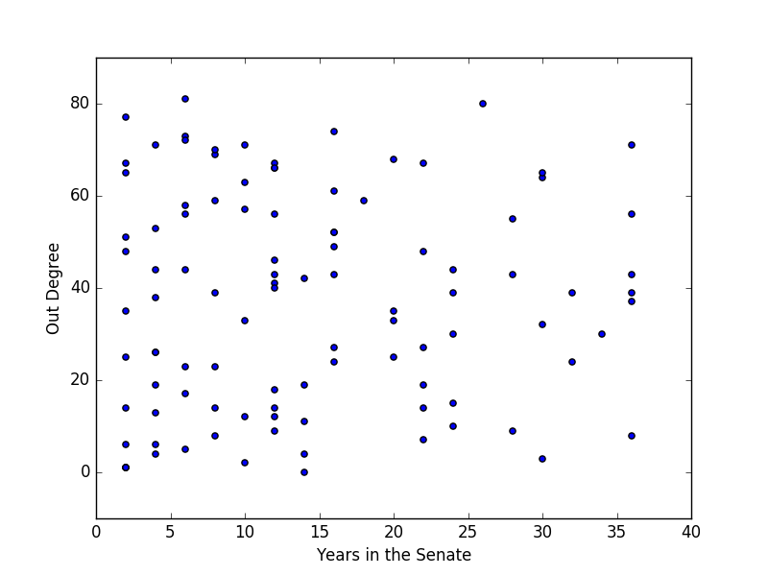
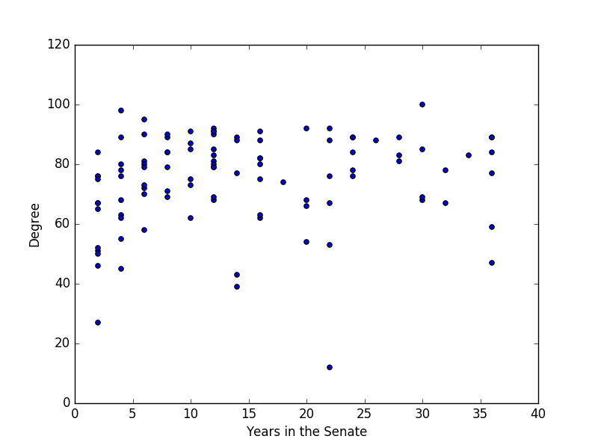
Can Degree Distribution Predict Seniority? (110’th Senate Pictured for more accurate seniority)

Slide 6
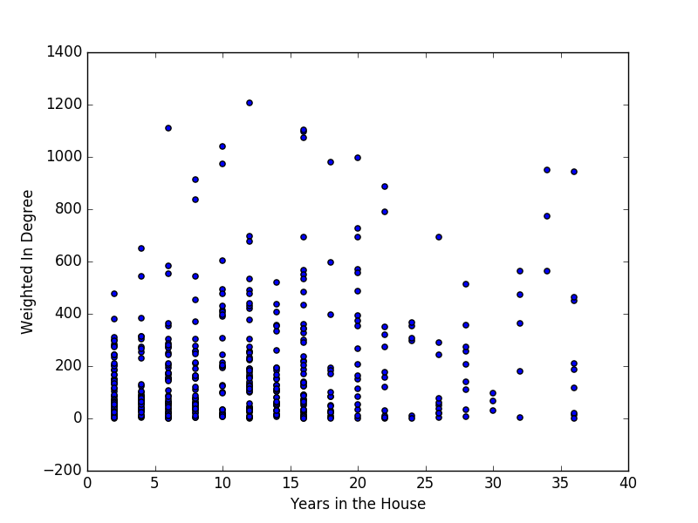
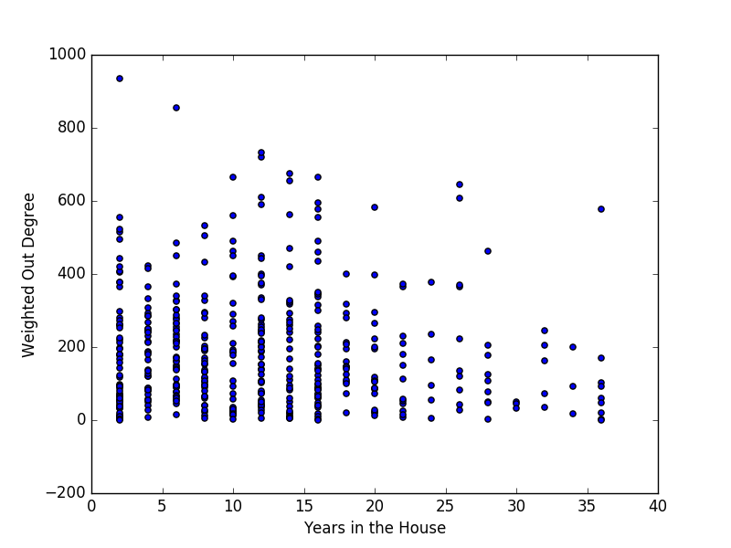
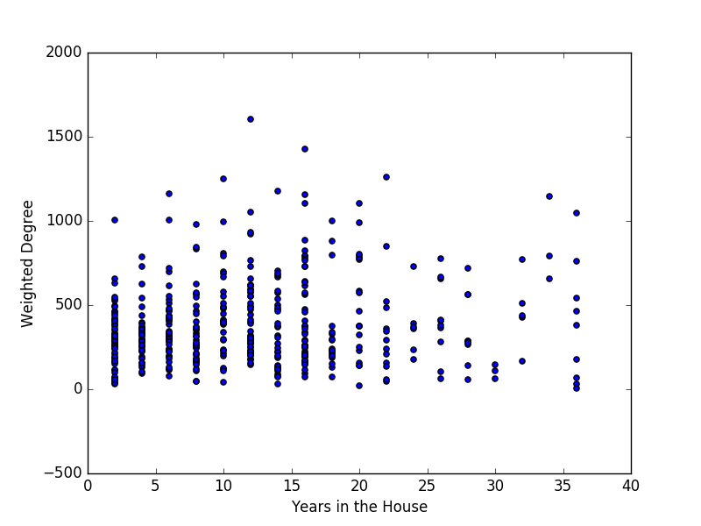
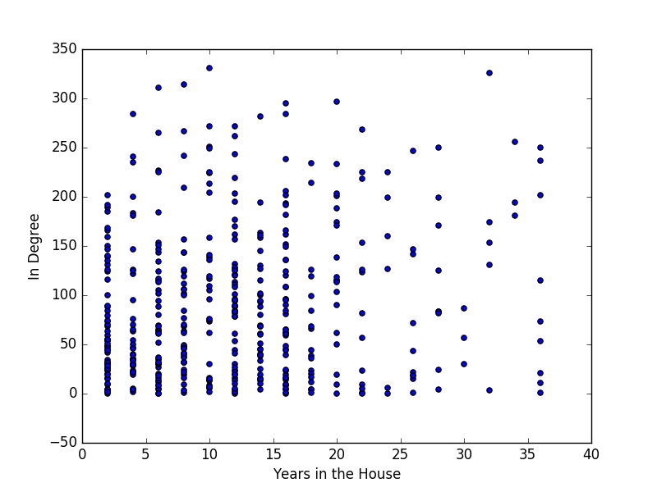
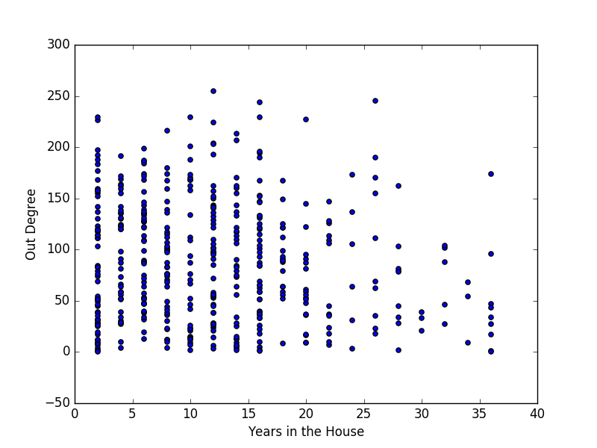
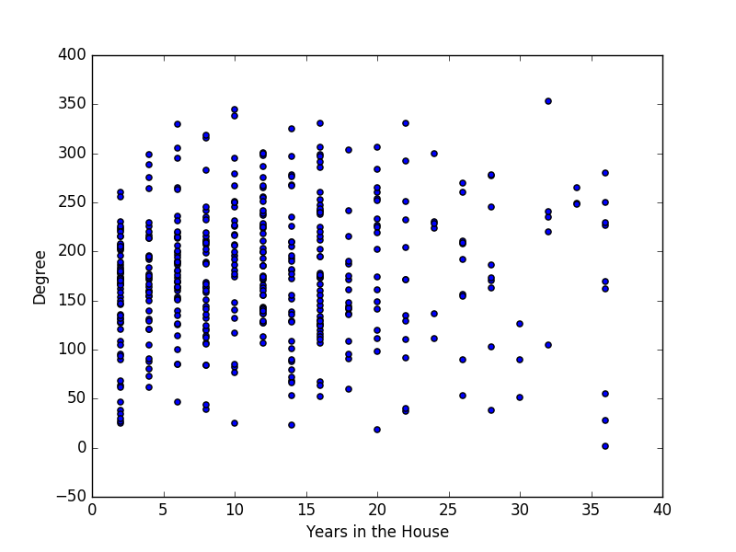
110th House
No clear linear relationship, weighted or unweighted
No significant relationship with betweeness centrality either

Slide 7
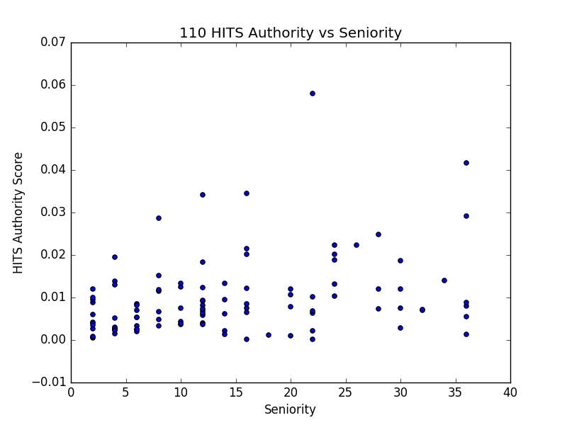
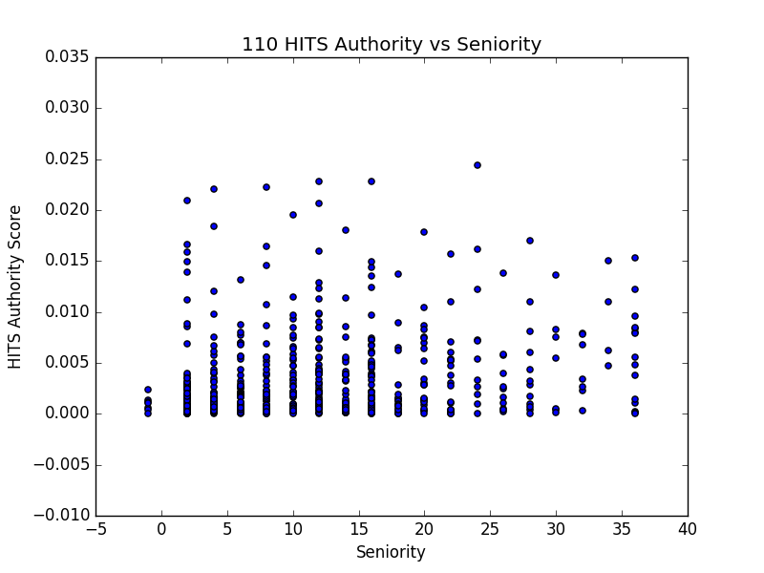
Maybe HITS? (link analysis algorithm)
Computes the “Authority” and “Hub” values
Hubs know good Authorities, good Authorities know good hubs
Based on adjacency matrix, so similar to weighted in/out degree

Slide 8
Seniority isn’t Authority
Senate, Top 10 Authority (2007)
Harry Reid
Edward M. Kennedy
Dianne Feinstein
Richard Durbin
Joseph R. Jr. Biden
Hillary Rodham Clinton
Christopher J. Dodd
Jeff Bingaman
John F. Kerry
Russell D. Feingold
Senate, top 10 Hubs (2007)
John F. Kerry
Richard Durbin
Barbara Boxer
Hillary Rodham Clinton
Robert Menendez
Sherrod Brown
Charles E. Schumer
Barack Obama
Olympia J. Snowe
Joseph I. Lieberman
Accurately identifies important people in the Senate

Slide 9
Didn’t work in the House
House, Top 10 Authority (2007)
Barbara Lee
Carolyn B. Maloney
Rosa L. DeLauro
John Lewis
George Miller
Eliot L. Engel
Janice D. Schakowsky
Lynn C. Woolsey
Lois Capps
Maxine Waters
House, top 10 Hubs (2007)
Raul M. Grijalva
Janice D. Schakowsky
Sheila Jackson-Lee
Steve Cohen
James P. McGovern
Donald M. Payne
Lynn C. Woolsey
Maurice D. Hinchey
Michael M. Honda
Bob Filner
Did not identify the Speaker of the House or major committee chairs
Speaker was 121st authority

